Slide 1
Chapter 9
Probability Models for Streak Shooting
Does hot hand exist?

Slide 2
9.1 Research Background and Objective
Key Question:
Are there times when a player has a higher (or lower) probability of making a prolonged series of shots?
Objective:
Address models for hot hand and cold hand hypothesis over an entire season to assess the potential impact of a supposed hot (or cold) hand.

Slide 3
Initial Discussion (Gilovich et al. 1985)
Data
1. Field goal & Free throw data from NBA
2. Controlled experiment using Cornell varsity basketball players taking shots from the same location
Method
Wald-Wolfitz run tests
Result
Not significant

Slide 4
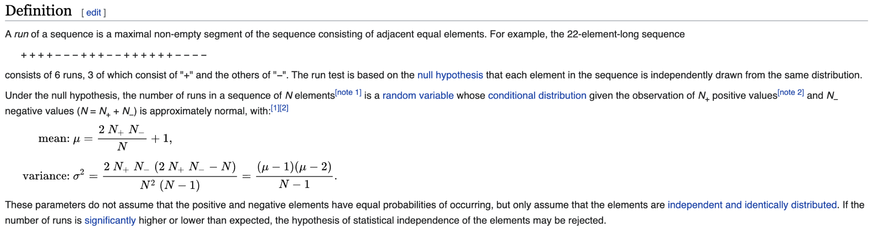
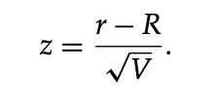
Wald-Wolfowitz runs test (Wikipedia)
Null Hypothesis: Randomness of the outcomes (assumed True)
Test Statistics:
(R → mean, V → variance, r → actual number of runs)

Slide 5
Further Discussions
Koehler and Conley, 2003
NBA three-point shooting contest over 4 years → not significant
Bar-Eli, 2005
Find limitied Support for hot hand hypothesis for different supports
Arkes, 2010 & 2013
Second free throw is more likely to be made when the first is made as well,
Hot hand does exist during the seasons

Slide 6
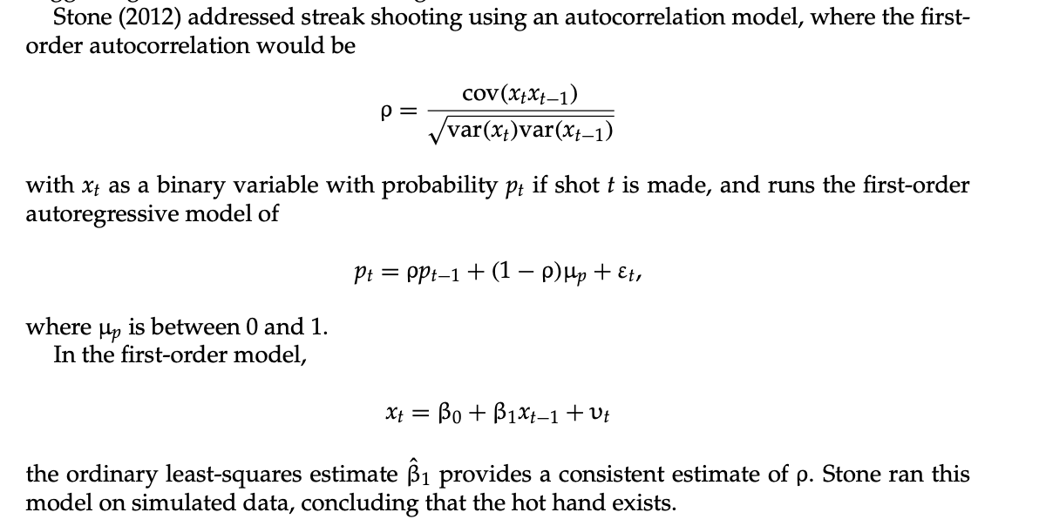
Autocorrelation model for streak shooting (Stone, 2012)
Simple Question: How to fit?
Conclusion: hot hand exists

Slide 7
Bias-corrected Probability Model (Miler and Sanjurjo, 2014)
Bias
It is more likely that head (made shot) is expected to be followed by tails (missed shot) than by heads, and it gets larger when the sequence length is greater.
Result
From their probability model, some players get the hot hand, some always shoot the same, some perform even worse.

Slide 8
Regression Model (Bocskocsky, 2014)
Theory
Each shot occurs under totally different conditions (shot distance, defensive metrics, player’s intrinsict ability, etc), i.e. each individual shot is made under a different expected probability
Result
High success results on recent shots are
1. more likely to take their next shot from a further distance than previous shots
2.more likely to take their team’s next shot

Slide 9
9.2 An Approach for Fixed / Controlled Data
Assumption: the distribution of shot outcomes is iid with a fixed probability of making each shot
M: a made shot, m: a missed shot
M_k represent a streak of k consecutive made shots (next is missed)
m_k represents a streak of k consecutive missed shots (next is made).
M2m3M1m2M2m1M1 is a set of events.
n_M1 = 2, n_M2 = 2, n_m1 = 1, n_m2= 1, n_m3 = 1.

Slide 10


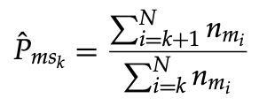
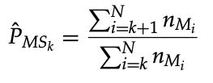


Model
Let p be the fixed probability of a made shot.
The probability of exactly k consecutive made / missed shots (the k+1st is missed / made) is
The probability of the next shot made following a sequence of k consecutive made / missed shots are P_MSk / P_Msk.
Sample estimate:

Slide 11
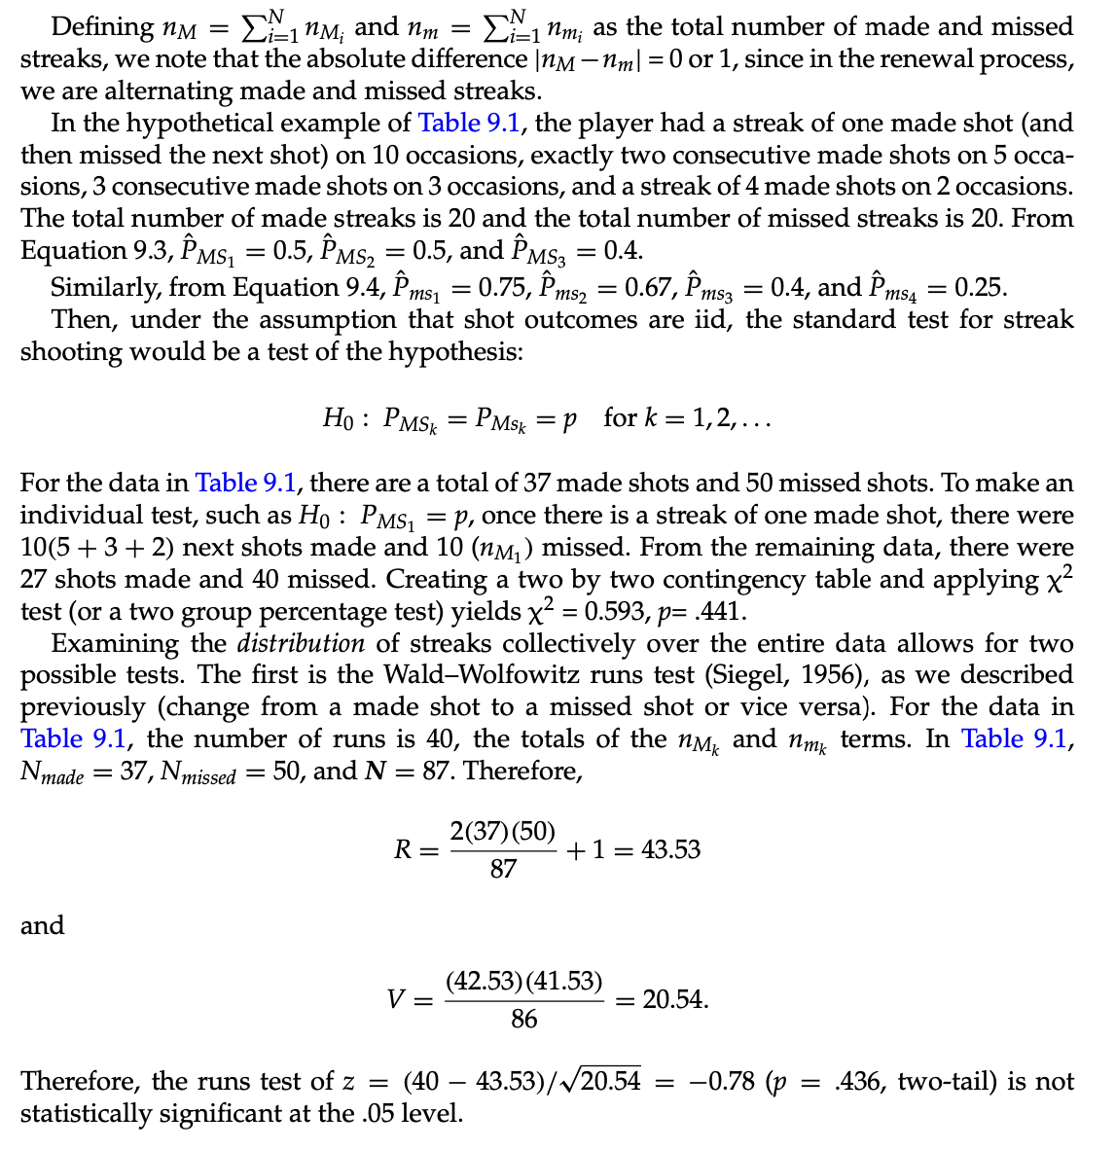
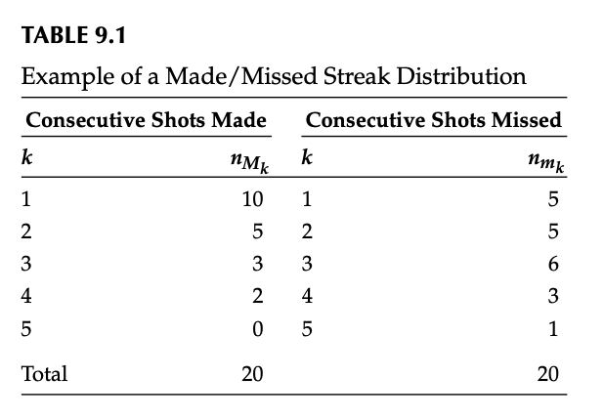
Example
H_0: P(Next made) == P(Next Miss)

Slide 12
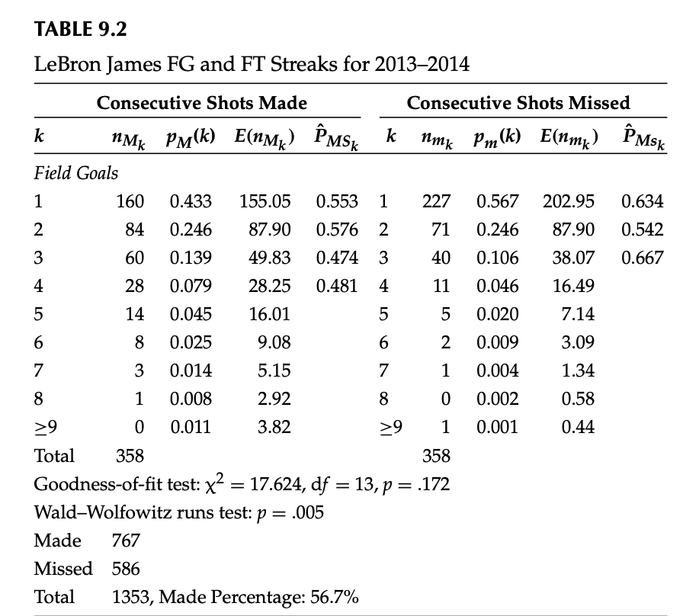
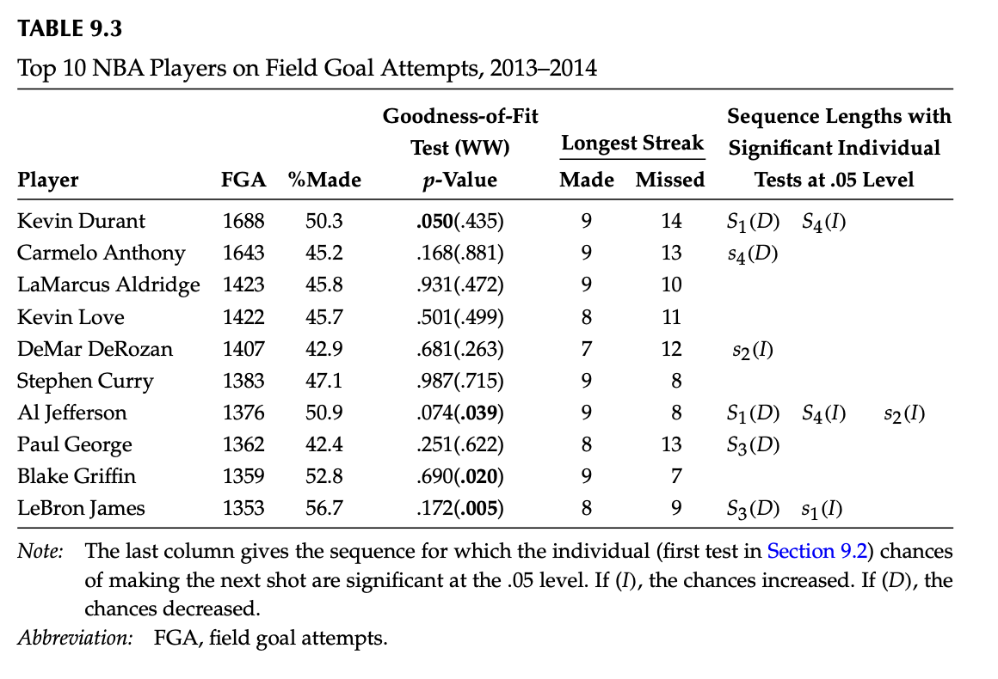
9.3 An Example: NBA Regular Season 2013-2014

Slide 13
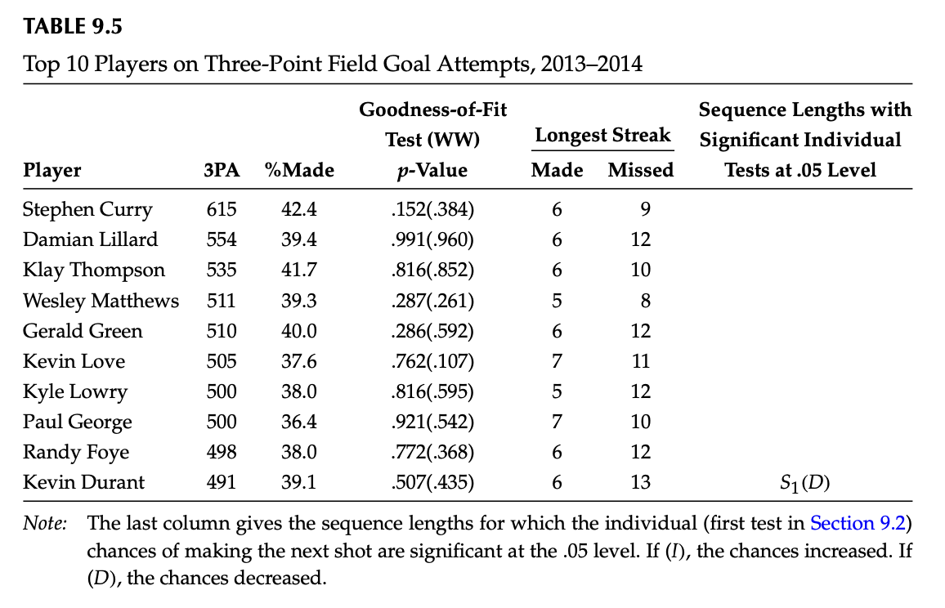
9.3 An Example: NBA Regular Season 2013-2014

Slide 14
9.4 Comments on Existing Methods
Fixed / Controlled study doesn’t take various circumstance into consideration (e.g. defensive pressure)
The Free Throw is the most reasonable one, but we still have to consider many factors (e.g. the quarter, the levels of foul)
A better way to examine streak under actual game condition is to use Regression model (Bosckocsky et al. 2014)

Slide 15
Three Possible Extension
Home game v.s. away game
Back to back game v.s. Few days rest game
Modeling the above conditions by fixed control or OLS methods.

